Slide 1
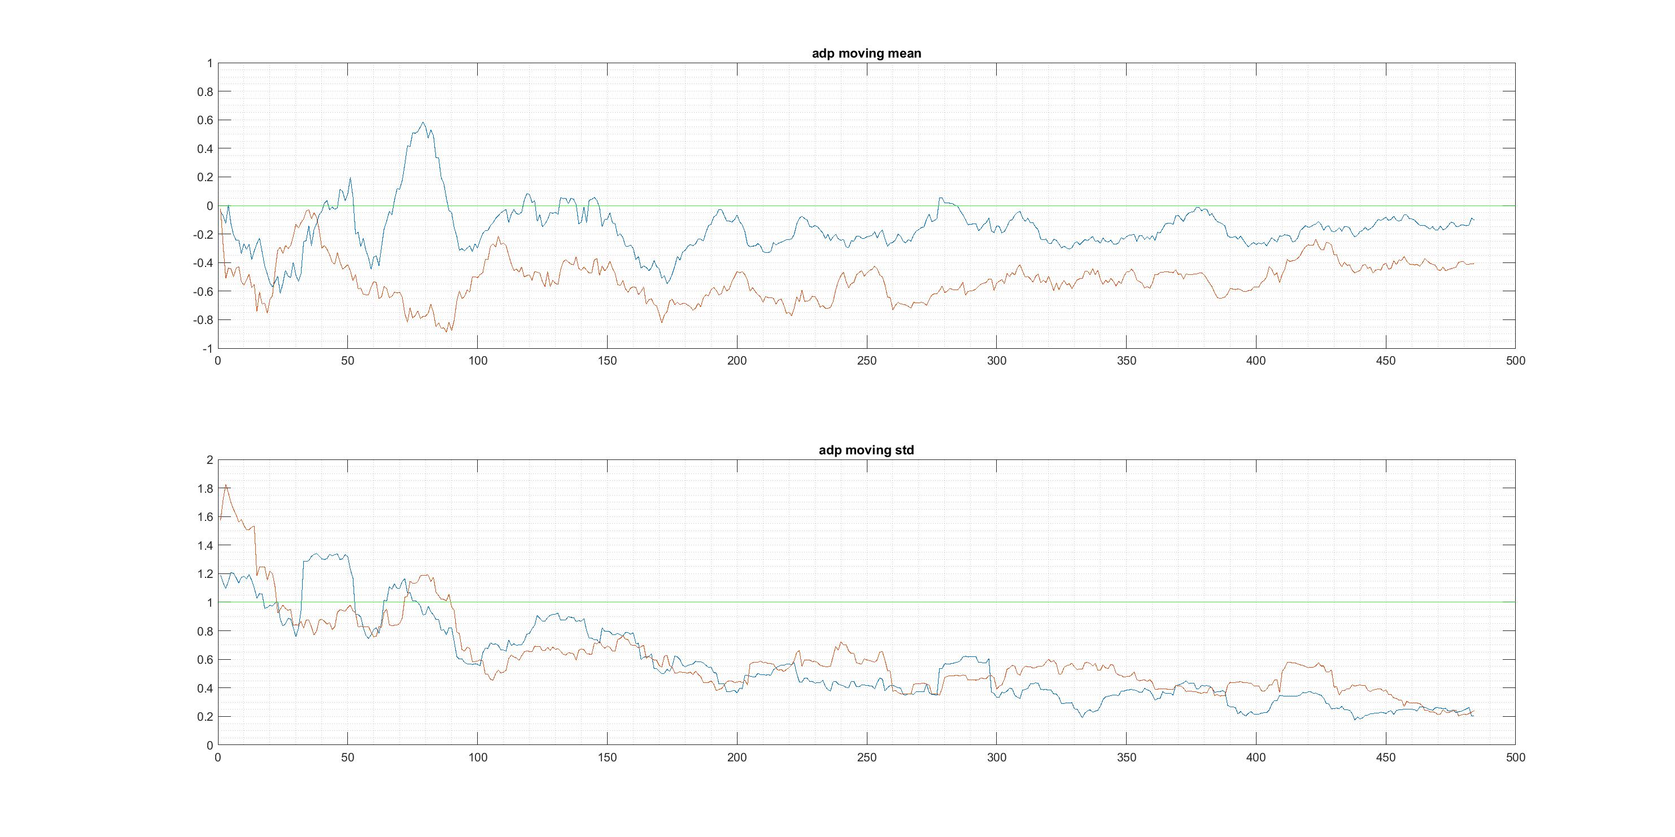
Find cutoff value of dfof_adapter for thresholding

Slide 2
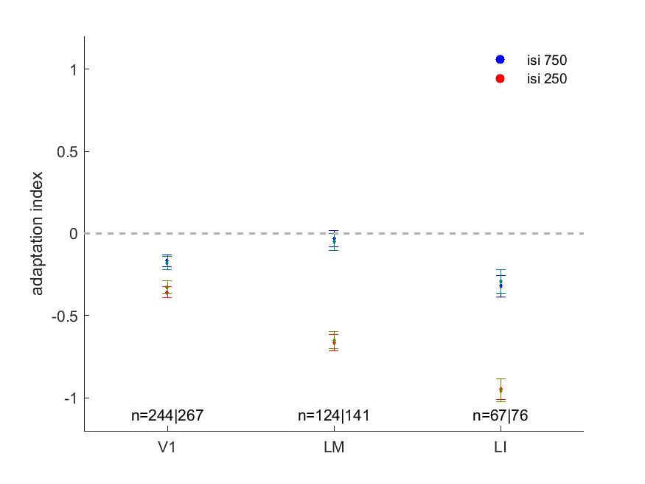
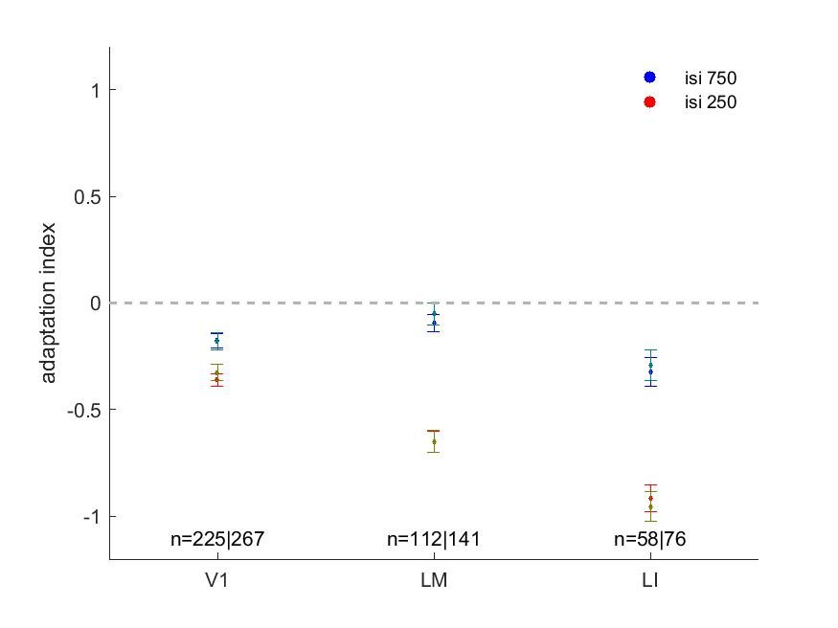
Limited impact of thresholding on adaptation magnitude

Slide 3
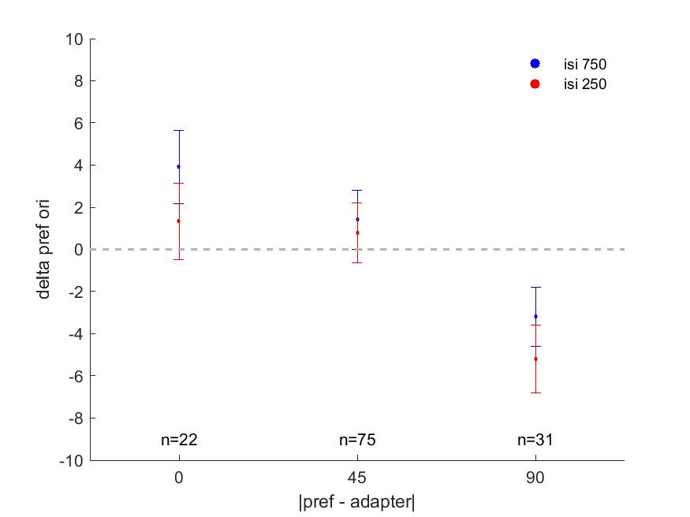
V1: change in preferred orientation as a function of the distance of the cells’ preferred orientation from the adapter

Slide 4
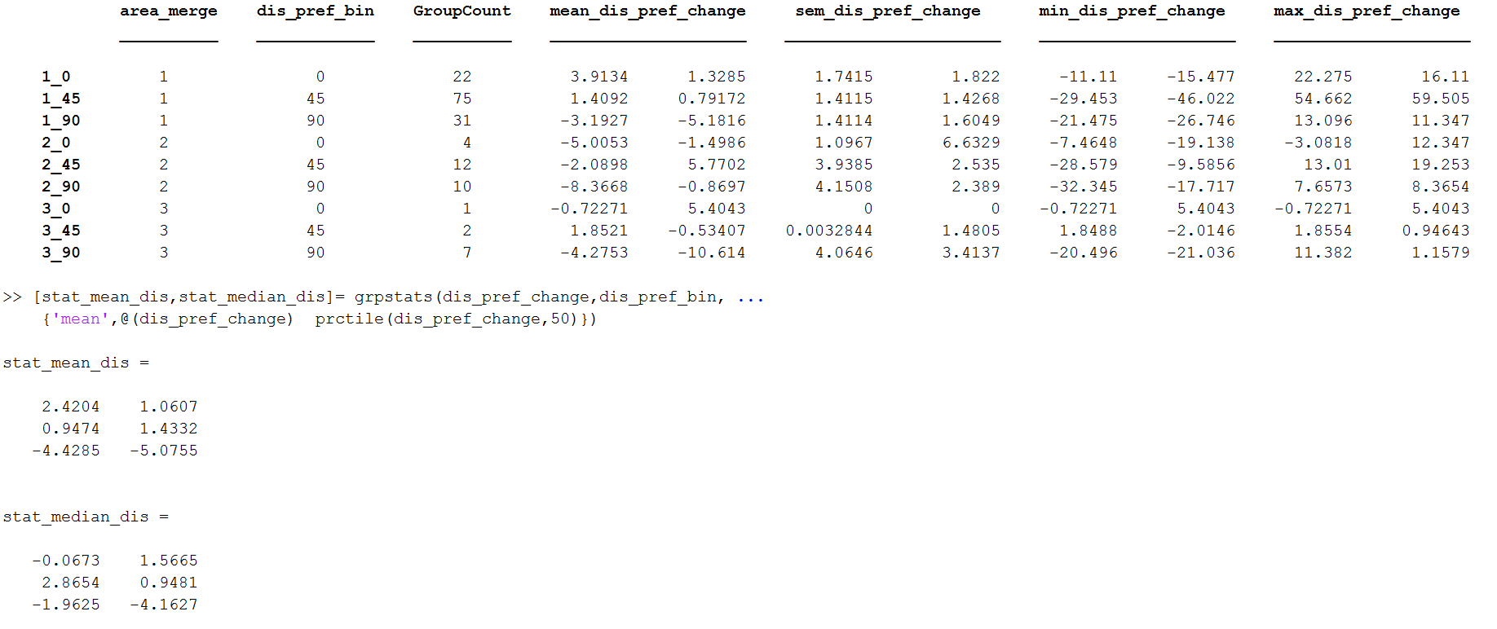
Need more cells for LM & LI

